Slide 1
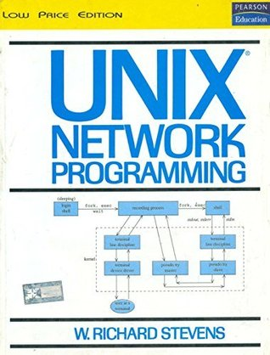
Network Programming

Slide 2
Unit – II 8 Hours
Sockets Introduction: Introduction, Socket Address Structures, Value-Result Arguments, Byte
Ordering and Manipulation Functions.
Elementary TCP Sockets: socket, connect, bind, listen, accept, fork and exec, Concurrent Server
design, getcsockname and getpeername functions.
Self-learning topics: TCP Echo Client/Server Functions.

Slide 3
Introduction:
Elementary socket functions are required to write a complete TCP client and server, along with concurrent servers.
Sockets Introduction: Most socket functions require a pointer to a socket address structure as an argument. Each supported protocol suite defines its own socket address structure. The names of these structures begin with sockaddr_ and end with a unique suffix for each protocol suite.
Socket address structures, can be passed in two directions:
Process to the kernel, example : Bind, connect, sendto and sendmsg.
Kernel to the process, example : accept, recvfrom, recvmsg, getpeername, getsockname.
All set the sin_len member before returning to the process.

Slide 4
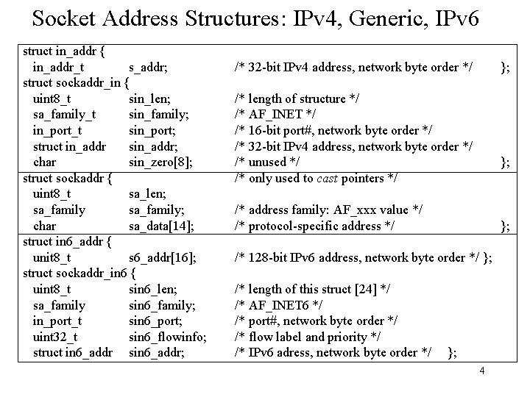

Slide 5
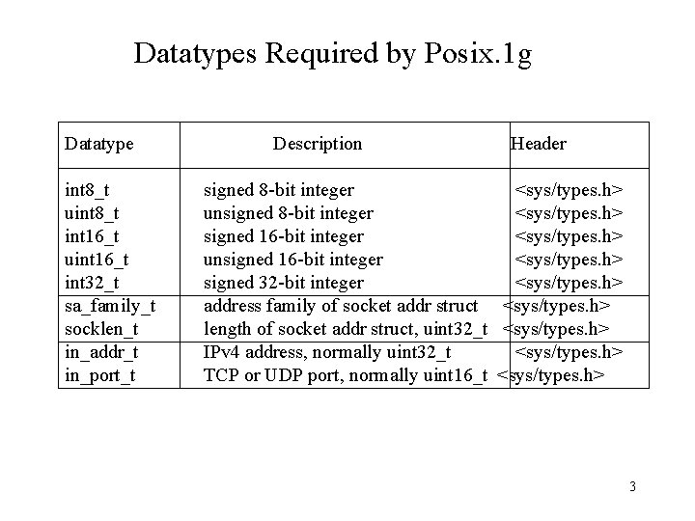

Slide 6
POSIX specifications requires only three members in the structure:
sin_family,
sin_addr, and
sin_port.
Almost all implementations add the sin_zero member so that all socket address structures are at least 16 bytes in size.
in_addr_t datatype must be an unsigned integer type of at least 32 bits.
in_port_t must be an unsigned integer type of at least 16 bits, and
sa_family_t can be any unsigned integer type. (8-bit unsigned integer or an unsigned 16-bit integer ).
The sin_zero member is unused.

Slide 7
Generic Socket Address Structure
A socket address structures is always passed by reference when passed as an argument to any socket functions. But any socket function that takes one of these pointers as an argument must deal with socket address structures from any of the supported protocol families.
use of these generic socket address structures :
cast pointers to protocol-specific structures. (Application programmer’s view)
kernel must take the caller's pointer, cast it to a struct sockaddr *, and then look at the value of sa_family to determine the type of the structure(Kernel;s view)
A generic socket address structure in the <sys/socket.h> header:
struct sockaddr {
uint8_t sa_len;
sa_family_t sa_family; /* address family: AF_xxx value */
char sa_data[14]; /* protocol-specific address */
};

Slide 8
The socket functions are then defined as taking a pointer to the generic socket address structure, as shown here in the ANSI C function prototype for the bind function:
I
int bind(int, struct sockaddr *, socklen_t);
Example:
struct sockaddr_in serv; /* IPv4 socket address structure */
/* fill in serv{} */
bind(sockfd, (struct sockaddr *) &serv, sizeof(serv));

Slide 9
For example:
IPv6 Socket Address Structure
The IPv6 socket address is defined by including the <netinet/in.h> header:
The SIN6_LEN constant must be defined if the system supports the length member for socket address structures.
The IPv6 family is AF_INET6, whereas the IPv4 family is AF_INET
The members in this structure are ordered so that if the sockaddr_in6 structure is 64-bit aligned, so is the 128-bit sin6_addr member.
The sin6_flowinfo member is divided into two fields:
The low-order 20 bits are the flow label
The high-order 12 bits are reserved
The sin6_scope_id identifies the scope zone in which a scoped address is meaningful, most commonly an interface index for a link-local address

Slide 10
we define SA to be the string struct sockaddr, just to shorten the code that we must write to cast these pointers.
From an application programmer ’s point of view, the only use of these generic socket address structures is to cast pointers to protocol-specific structures.
From the kernel’s perspective, another reason for using pointers to generic socket address structures as arguments is that the kernel must take the caller’s pointer, cast it to a struct sockaddr *, and then look at the value of sa_family to determine the type of the structure.

Slide 11
New Generic Socket Address Structure
A new generic socket address structure was defined as part of the IPv6 sockets API, to overcome some of the shortcomings of the existing struct sockaddr. Unlike the struct sockaddr, the new struct sockaddr_storage is large enough to hold any socket address type supported by the system. The sockaddr_storage structure is defined by including the <netinet/in.h> header:
The sockaddr_storage type provides a generic socket address structure that is different from struct sockaddr in two ways:
If any socket address structures that the system supports have alignment requirements, the sockaddr_storage provides the strictest alignment requirement.
The sockaddr_storage is large enough to contain any socket address structure that the system supports.
The fields of the sockaddr_storage structure are opaque to the user, except for ss_family and ss_len (if present). The sockaddr_storage must be cast or copied to the appropriate socket address structure for the address given in ss_family to access any other fields.

Slide 12
Value-Result Arguments
When a socket address structure is passed to any socket function, it is always passed by reference (a pointer to the structure is passed). The length of the structure is also passed as an argument.
The way in which the length is passed depends on which direction the structure is being passed:
From the process to the kernel
From the kernel to the process
From process to kernel
bind, connect, and sendto functions pass a socket address structure from the process to the kernel.
Arguments to these functions:
The pointer to the socket address structure
The integer size of the structure
struct sockaddr_in serv; /* fill in serv{} */ connect (sockfd, (SA *) &serv, sizeof(serv));

Slide 13
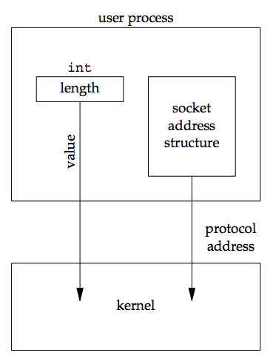
From the process to the kernel
The datatype for the size of a socket address structure is actually socklen_t and not int, but the POSIX specification recommends that socklen_t be defined as uint32_t.

Slide 14
From kernel to process
accept, recvfrom, getsockname, and getpeername functions pass a socket address structure from the kernel to the process.
Arguments to these functions:
The pointer to the socket address structure
The pointer to an integer containing the size of the structure.
struct sockaddr_un cli; /* Unix domain */
socklen_t len;
len = sizeof(cli); /* len is a value */
getpeername(unixfd, (SA *) &cli, &len); /* len may have changed */

Slide 15
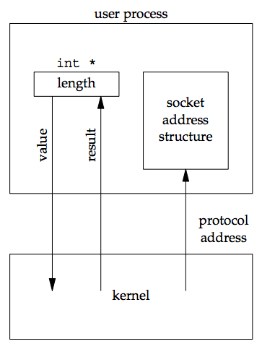
From kernel to process

Slide 16
Value-result argument
The size changes from an integer to be a pointer to an integer because the size is both a value when the function is called and a result when the function returns.
As a value: it tells the kernel the size of the structure so that the kernel does not write past the end of the structure when filling it in.
As a result: it tells the process how much information the kernel actually stored in the structure
For two other functions that pass socket address structures, recvmsg and sendmsg, the length field is not a function argument but a structure member.
If the socket address structure is fixed-length, the value returned by the kernel will always be that fixed size: 16 for an IPv4 sockaddr_in and 28 for an IPv6 sockaddr_in6. But with a variable-length socket address structure (e.g., a Unix domain sockaddr_un), the value returned can be less than the maximum size of the structure.
Though the most common example of a value-result argument is the length of a returned socket address structure, we encounter other value-result arguments :
The middle three arguments for the select function.
The length argument for the getsockopt function.
The msg_namelen and msg_controllen members of the msghdr structure, when used with recvmsg.
The ifc_len member of the ifconf structure.
The first of the two length arguments for the sysctl function.

Slide 17
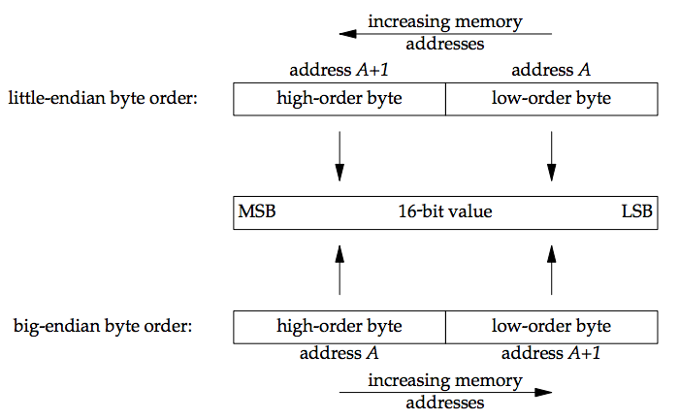
For a 16-bit integer that is made up of 2 bytes, there are two ways to store the two bytes in memory: Little-endian order: low-order byte is at the starting address. Big-endian order: high-order byte is at the starting address.

Slide 18
Host byte order refer to the byte ordering used by a given system. The program below prints the host byte order:
#include "unp.h"
 | int
 | main(int argc, char **argv)
 | {
 | union {
 | short s;
 | char c[sizeof(short)];
 | } un;
 | un.s = 0x0102;
 | printf("%s: ", CPU_VENDOR_OS);
 | if (sizeof(short) == 2) {
 | if (un.c[0] == 1 && un.c[1] == 2)
 | printf("big-endian\n");
 | else if (un.c[0] == 2 && un.c[1] == 1)
 | printf("little-endian\n");
 | else
 | printf("unknown\n");
 | } else
 | exit(0); }

Slide 19
We store the two-byte value 0x0102 in the short integer and then look at the two consecutive bytes, c[0] (the address A) and c[1] (the address A+1) to determine the byte order.
The string CPU_VENDOR_OS is determined by the GNU autoconf program.
Networking protocols must specify a network byte order. The sending protocol stack and the receiving protocol stack must agree on the order in which the bytes of these multibyte fields will be transmitted. The Internet protocols use big-endian byte ordering for these multibyte integers.
But, both history and the POSIX specification say that certain fields in the socket address structures must be maintained in network byte order. We use the following four functions to convert between these two byte orders:
#include <netinet/in.h>
uint16_t htons(uint16_t host16bitvalue);
uint32_t htonl(uint32_t host32bitvalue);
/* Both return: value in network byte order */
uint16_t ntohs(uint16_t net16bitvalue);
uint32_t ntohl(uint32_t net32bitvalue); /* Both return: value in host byte order */
h stands for host
n stands for network
s stands for short (16-bit value, e.g. TCP or UDP port number)
l stands for long (32-bit value, e.g. IPv4 address)

Slide 20
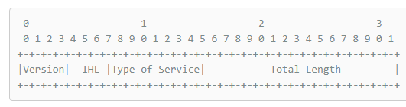
When using these functions, we do not care about the actual values (big-endian or little-endian) for the host byte order and the network byte order. What we must do is call the appropriate function to convert a given value between the host and network byte order. On those systems that have the same byte ordering as the Internet protocols (big-endian), these four functions are usually defined as null macros.
We use the term "byte" to mean an 8-bit quantity since almost all current computer systems use 8-bit bytes. Most Internet standards use the term octet instead of byte to mean an 8-bit quantity.
Bit ordering is an important convention in Internet standards, such as the the first 32 bits of the IPv4 header from RFC 791:
This represents four bytes in the order in which they appear on the wire; the leftmost bit is the most significant. However, the numbering starts with zero assigned to the most significant bit

Slide 21
Byte Manipulation Functions
There are two groups of functions that operate on multibyte fields, without interpreting the data, and without assuming that the data is a null-terminated C string. We need these types of functions when dealing with socket address structures because we need to manipulate fields such as IP addresses, which can contain bytes of 0, but are not C character strings. The functions beginning with str (for string), defined by including the header, deal with null-terminated C character strings.
The first group of functions, whose names begin with b (for byte), are from 4.2BSD and are still provided by almost any system that supports the socket functions. The second group of functions, whose names begin with mem (for memory), are from the ANSI C standard and are provided with any system that supports an ANSI C library.
We first show the Berkeley-derived functions, although the only one we use in this text is bzero. (We use it because it has only two arguments and is easier to remember than the three-argument memset function, as explained on p. 8.) You may encounter the other two functions, bcopy and bcmp, in existing applications.
unp_bzero.h
#include <strings.h>
void bzero(void *dest, size_t nbytes);
void bcopy(const void *src, void *dest, size_t nbytes);
int bcmp(const void *ptr1, const void *ptr2, size_t nbytes); /* Returns: 0 if equal, nonzero if unequal */

Slide 22
The memory pointed to by the const pointer is read but not modified by the function.
bzero sets the specified number of bytes to 0 in the destination. We often use this function to initialize a socket address structure to 0.
bcopy moves the specified number of bytes from the source to the destination.
bcmp compares two arbitrary byte strings. The return value is zero if the two byte strings are identical; otherwise, it is nonzero.
unp_memset.h
#include <string.h>
void *memset(void *dest, int c, size_t len);
void *memcpy(void *dest, const void *src, size_t nbytes);
int memcmp(const void *ptr1, const void *ptr2, size_t nbytes);
/* Returns: 0 if equal, <0 or >0 if unequal (see text) */

Slide 23
memset sets the specified number of bytes to the value c in the destination. memcpy is similar to bcopy, but the order of the two pointer arguments is swapped. bcopy correctly handles overlapping fields, while the behavior of memcpy is undefined if the source and destination overlap. The ANSI C memmove function must be used when the fields overlap. One way to remember the order of the two pointers for memcpy is to remember that they are written in the same left-to-right order as an assignment statement in C: dest = src; One way to remember the order of the final two arguments to memset is to realize that all of the ANSI C memXXX functions require a length argument, and it is always the final argument.
memcmp compares two arbitrary byte strings and returns 0 if they are identical. If not identical, the return value is either greater than 0 or less than 0, depending on whether the first unequal byte pointed to by ptr1 is greater than or less than the corresponding byte pointed to by ptr2. The comparison is done assuming the two unequal bytes are unsigned chars.

Slide 24
Elementary TCP Sockets
Introduction
This chapter describes the elementary socket functions required to write a complete TCP client and server, along with concurrent servers, a common Unix technique for providing concurrency when numerous clients are connected to the same server at the same time. Each client connection causes the server to fork a new process just for that client. In this chapter, we consider only the one-process-per-client model using fork.
The figure below shows a timeline of the typical scenario that takes place between a TCP client and server. First, the server is started, then sometime later, a client is started that connects to the server. We assume that the client sends a request to the server, the server processes the request, and the server sends a reply back to the client. This continues until the client closes its end of the connection, which sends an end-of-file notification to the server. The server then closes its end of the connection and either terminates or waits for a new client connection.

Slide 25
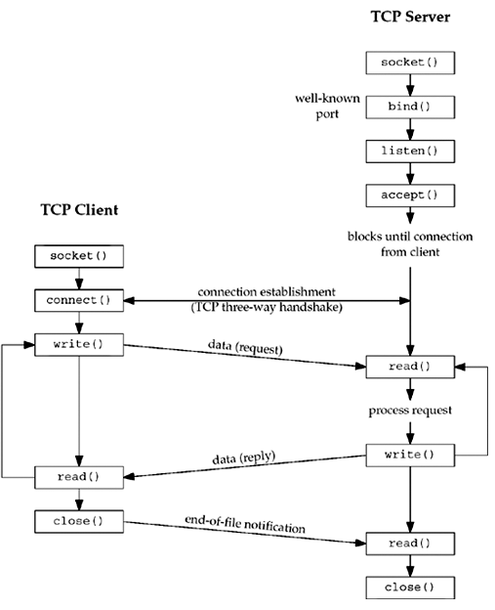
Socket functions for elementary TCP client/server.

Slide 26
Socket Functions
To perform network I/O, the first thing a process must do is call the socket function, specifying the type of communication protocol desired (TCP using IPv4, UDP using IPv6, Unix domain stream protocol, etc.).
#include <sys/socket.h>
int socket (int family, int type, int protocol);
/* Returns: non-negative descriptor if OK, -1 on error */
Arguments:
family specifies the protocol family and is one of the constants in the table below. This argument is often referred to as domain instead of family.

Slide 27
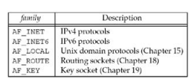
Protocol family constants for socket function.

Slide 28
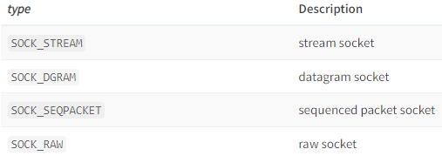
Type of socket fot socket functions

Slide 29
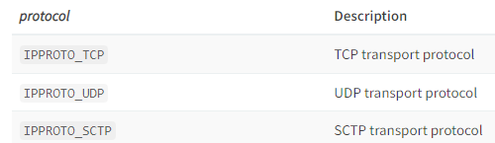
Protocol of sockets for AF_INET or AF_INET6
The protocol argument to the socket function should be set to the specific protocol type found in the table below, or 0 to select the system's default for the given combination of family and type.

Slide 30

Combinations of family and type for the socket function.

Slide 31
On success, the socket function returns a small non-negative integer value, similar to a file descriptor. We call this a socket descriptor, or a sockfd. To obtain this socket descriptor, all we have specified is a protocol family (IPv4, IPv6, or Unix) and the socket type (stream, datagram, or raw). We have not yet specified either the local protocol address or the foreign protocol address.
AF_xxx Versus PF_xxx
The "AF_" prefix stands for "address family" and the "PF_" prefix stands for "protocol family." Historically, the intent was that a single protocol family might support multiple address families and that the PF_ value was used to create the socket and the AF_ value was used in socket address structures. But in actuality, a protocol family supporting multiple address families has never been supported and the <sys/socket.h> header defines the PF_ value for a given protocol to be equal to the AF_ value for that protocol. While there is no guarantee that this equality between the two will always be true, should anyone change this for existing protocols, lots of existing code would break.
To conform to existing coding practice, we use only the AF_ constants in this text, although you may encounter the PF_ value, mainly in calls to socket.

Slide 32
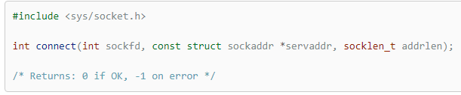
connect Function
The connect function is used by a TCP client to establish a connection with a TCP server.
sockfd is a socket descriptor returned by the socket function.
The servaddr and addrlen arguments are a pointer to a socket address structure (which contains the IP address and port number of the server) and its size.
The client does not have to call bind before calling connect: the kernel will choose both an ephemeral port and the source IP address if necessary. In the case of a TCP socket, the connect function initiates TCP's three-way handshake (Section 2.6). The function returns only when the connection is established or an error occurs. There are several different error returns possible.

Slide 33
2. If the server's response to the client's SYN is a reset (RST), this indicates that no process is waiting for connections on the server host at the port specified (the server process is probably not running). This is a hard error and the error ECONNREFUSED is returned to the client as soon as the RST is received. An RST is a type of TCP segment that is sent by TCP when something is wrong. Three conditions that generate an RST are:
When a SYN arrives for a port that has no listening server.
When TCP wants to abort an existing connection.
When TCP receives a segment for a connection that does not exist.
3. If the client's SYN elicits an ICMP "destination unreachable" from some intermediate router, this is considered a soft error. The client kernel saves the message but keeps sending SYNs with the same time between each SYN as in the first scenario. If no response is received after some fixed amount of time (75 seconds for 4.4BSD), the saved ICMP error is returned to the process as either EHOSTUNREACH or ENETUNREACH. It is also possible that the remote system is not reachable by any route in the local system's forwarding table, or that the connect call returns without waiting at all. Note that network unreachables are considered obsolete, and applications should just treat ENETUNREACH and EHOSTUNREACH as the same error.
1. If the client TCP receives no response to its SYN segment, ETIMEDOUT is returned. 4.4BSD, for example, sends one SYN when connect is called, another 6 seconds later, and another 24 seconds later (p. 828 of TCPv2). If no response is received after a total of 75 seconds, the error is returned.

Slide 34
Example: nonexistent host on the local subnet *
We run the client daytimetcpcli and specify an IP address that is on the local subnet (192.168.1/24) but the host ID (100) is nonexistent. When the client host sends out ARP requests (asking for that host to respond with its hardware address), it will never receive an ARP reply.
solaris % daytimetcpcli 192.168.1.100 connect error: Connection timed out
We only get the error after the connect times out. Notice that our err_sys function prints the human-readable string associated with the ETIMEDOUT error.
Example: no server process running *
We specify a host (a local router) that is not running a daytime server:
solaris % daytimetcpcli 192.168.1.5 connect error: Connection refused
The server responds immediately with an RST.

Slide 35
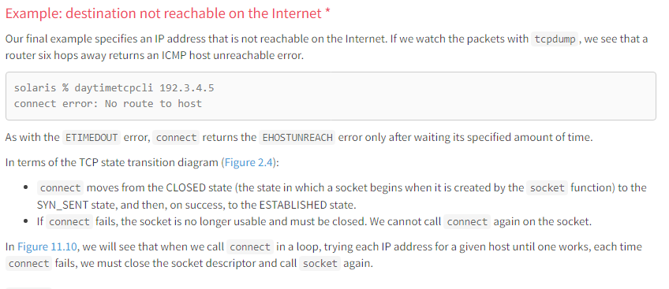

Slide 36
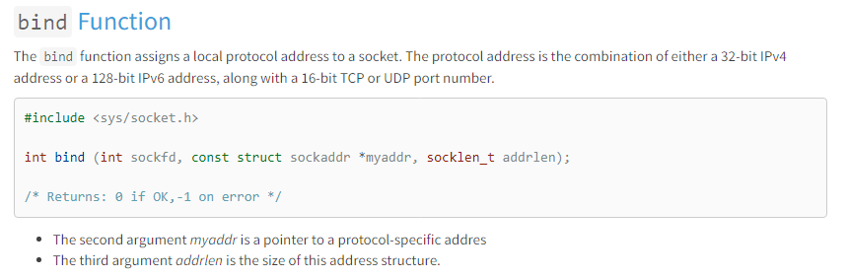

Slide 37
Servers bind their well-known port when they start. If a TCP client or server does not do this, the kernel chooses an ephemeral port for the socket when either connect or listen is called.
It is normal for a TCP client to let the kernel choose an ephemeral port, unless the application requires a reserved port (Figure 2.10)
However, it is rare for a TCP server to let the kernel choose an ephemeral port, since servers are known by their well-known port.
Exceptions to this rule are Remote Procedure Call (RPC) servers. They normally let the kernel choose an ephemeral port for their listening socket since this port is then registered with the RPC port mapper. Clients have to contact the port mapper to obtain the ephemeral port before they can connect to the server. This also applies to RPC servers using UDP.
A process can bind a specific IP address to its socket. The IP address must belong to an interface on the host.
For a TCP client, this assigns the source IP address that will be used for IP datagrams sent on the socket. Normally, a TCP client does not bind an IP address to its socket. The kernel chooses the source IP address when the socket is connected, based on the outgoing interface that is used, which in turn is based on the route required to reach the server
For a TCP server, this restricts the socket to receive incoming client connections destined only to that IP address. If a TCP server does not bind an IP address to its socket, the kernel uses the destination IP address of the client's SYN as the server's source IP address.

Slide 38
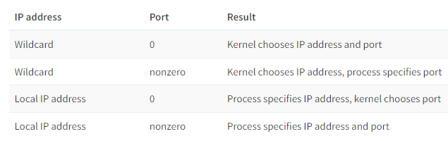
Calling bind lets us specify the IP address, the port, both, or neither. The following table summarizes the values to which we set sin_addr and sin_port, or sin6_addr and sin6_port, depending on the desired result.

Slide 39
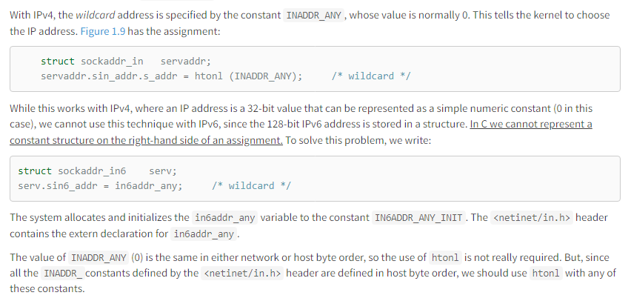
If we specify a port number of 0, the kernel chooses an ephemeral port when bind is called. But if we specify a wildcard IP address, the kernel does not choose the local IP address until either the socket is connected (TCP) or a datagram is sent on the socket (UDP).

Slide 40
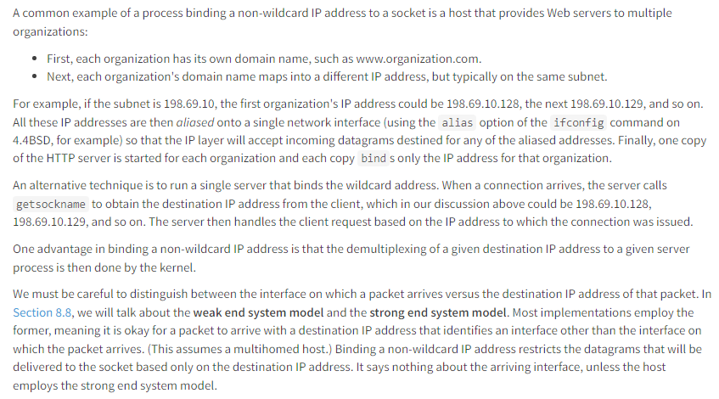
Binding a non-wildcard IP address

Slide 41
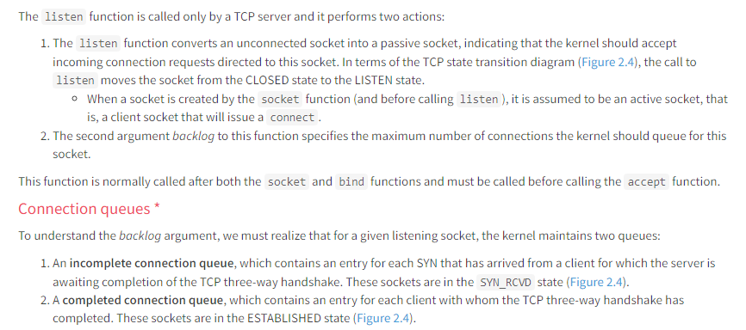
listen Function

Slide 42
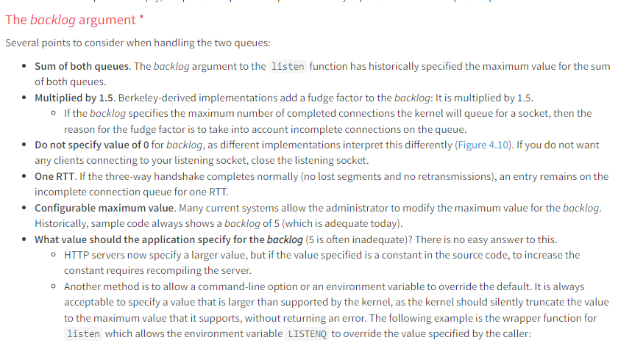

Slide 43
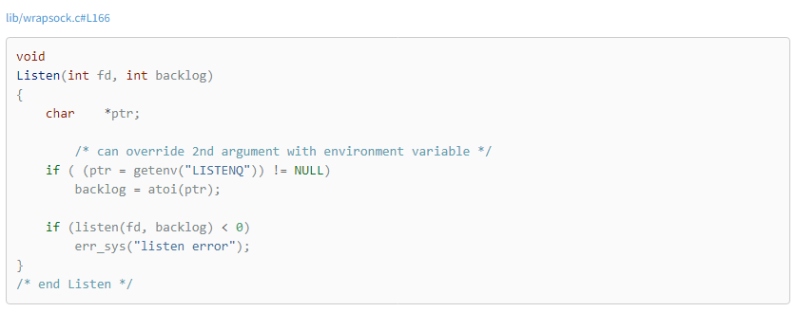

Slide 44
Fixed number of connections. Historically the reason for queuing a fixed number of connections is to handle the case of the server process being busy between successive calls to accept. This implies that of the two queues, the completed queue should normally have more entries than the incomplete queue. Again, busy Web servers have shown that this is false. The reason for specifying a large backlog is because the incomplete connection queue can grow as client SYNs arrive, waiting for completion of the three-way handshake.
No RST sent if queues are full. If the queues are full when a client SYN arrives, TCP ignores the arriving SYN; it does not send an RST. This is because the condition is considered temporary, and the client TCP will retransmit its SYN, hopefully finding room on the queue in the near future. If the server TCP immediately responded with an RST, the client's connect would return an error, forcing the application to handle this condition instead of letting TCP's normal retransmission take over. Also, the client could not differentiate between an RST in response to a SYN meaning "there is no server at this port" versus "there is a server at this port but its queues are full."
Data queued in the socket's receive buffer. Data that arrives after the three-way handshake completes, but before the server calls accept, should be queued by the server TCP, up to the size of the connected socket's receive buffer.

Slide 45
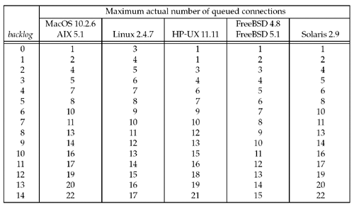
The following figure shows actual number of queued connections for values of backlog:

Slide 46
accept Function
accept is called by a TCP server to return the next completed connection from the front of the completed connection queue (Figure 4.7). If the completed connection queue is empty, the process is put to sleep (assuming the default of a blocking socket).
#include <sys/socket.h>
int accept (int sockfd, struct sockaddr *cliaddr, socklen_t *addrlen); /* Returns: non-negative descriptor if OK, -1 on error */
The cliaddr and addrlen arguments are used to return the protocol address of the connected peer process (the client). addrlen is a value-result argument (Section 3.3):
Before the call, we set the integer value referenced by *addrlen to the size of the socket address structure pointed to by cliaddr;
On return, this integer value contains the actual number of bytes stored by the kernel in the socket address structure.

Slide 47
If successful, accept returns a new descriptor automatically created by the kernel. This new descriptor refers to the TCP connection with the client.
The listening socket is the first argument (sockfd) to accept (the descriptor created by socket and used as the first argument to both bind and listen).
The connected socket is the return value from accept the connected socket.
It is important to differentiate between these two sockets:
A given server normally creates only one listening socket, which then exists for the lifetime of the server.
The kernel creates one connected socket for each client connection that is accepted (for which the TCP three-way handshake completes).
When the server is finished serving a given client, the connected socket is closed.
This function returns up to three values:
An integer return code that is either a new socket descriptor or an error indication,
The protocol address of the client process (through the cliaddr pointer),
The size of this address (through the addrlen pointer).
If we are not interested in having the protocol address of the client returned, we set both cliaddr and addrlen to null pointers. See intro/daytimetcpsrv.c.

Slide 48
fork and exec Functions
Before describing how to write a concurrent server in the next section, we must describe the Unix fork function.
This function (including the variants of it provided by some systems) is the only way in Unix to create a new process.
#include <unistd.h>
pid_t fork(void); Returns: 0 in child, process ID of child in parent, -1 on error.
fork it returns values twice. It returns once in the calling process (called the parent) with a return value that is the process ID of the newly created process (the child). It also returns once in the child, with a return value of 0. Hence, the return value tells the process whether it is the parent or the child.
The reason fork returns 0 in the child, instead of the parent's process ID, is because a child has only one parent and it can always obtain the parent's process ID by calling getppid. A parent, on the other hand, can have any number of children, and there is no way to obtain the process IDs of its children. If a parent wants to keep track of the process IDs of all its children, it must record the return values from fork.

Slide 49
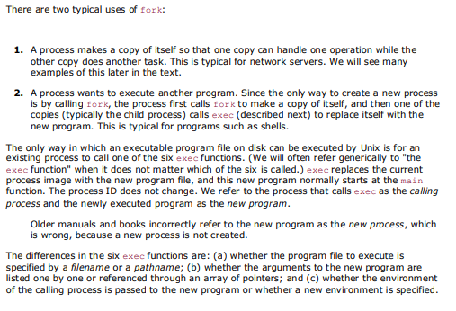

Slide 50
#include <unistd.h>
Int execl (const char *pathname, const char *arg0, ... /* (char *) 0 */ );
int execv (const char *pathname, char *constargv[]);
int execle (const char *pathname, const char *arg0, ... /* (char *) 0, char *constenvp[] */ );
int execve (const char *pathname, char *constargv[], char *constenvp[]); int execlp (const char *filename, const char *arg0, ... /* (char *) 0 */ );
int execvp (const char *filename, char *constargv[]);
All six return: -1 on error, no return on success .
These functions return to the caller only if an error occurs. Otherwise, control passes to the start of the new program, normally the main function.

Slide 51
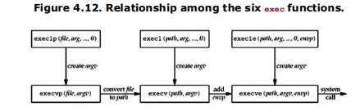
The relationship among these six functions is shown in Figure 4.12. Normally, only execve is a system call within the kernel and the other five are library functions that call execve.

Slide 52
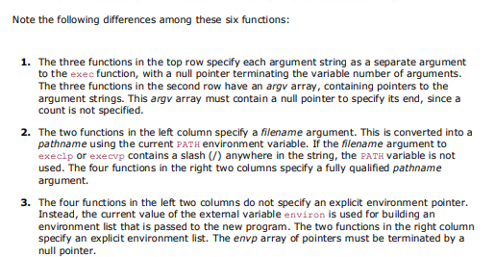

Slide 53
Concurrent Servers
The server described in intro/daytimetcpsrv1.c is an iterative server. But when a client request can take longer to service, we do not want to tie up a single server with one client; we want to handle multiple clients at the same time. The simplest way to write a concurrent server under Unix is to fork a child process to handle each client.
The following code shows the outline for a typical concurrent server:
pid_t pid;
int listenfd, connfd;
listenfd = Socket( ... );
/* fill in sockaddr_in{} with server's well-known port */
Bind(listenfd, ... );
Listen(listenfd, LISTENQ);
for ( ; ; )
{ connfd = Accept (listenfd, ... ); /* probably blocks */
if( (pid = Fork()) == 0)
{ Close(listenfd); /* child closes listening socket */
doit(connfd); /* process the request */
Close(connfd); /* done with this client */
exit(0); /* child terminates */ }
Close(connfd); /* parent closes connected socket */
}

Slide 54
When a connection is established, accept returns, the server calls fork, and the child process services the client (on connfd, the connected socket) and the parent process waits for another connection (on listenfd, the listening socket). The parent closes the connected socket since the child handles the new client.
We assume that the function doit does whatever is required to service the client. When this function returns, we explicitly close the connected socket in the child. This is not required since the next statement calls exit, and part of process termination is to close all open descriptors by the kernel. Whether to include this explicit call to close or not is a matter of personal programming taste.

Slide 55
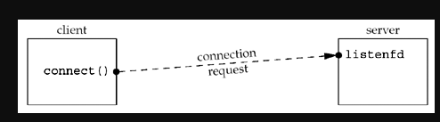
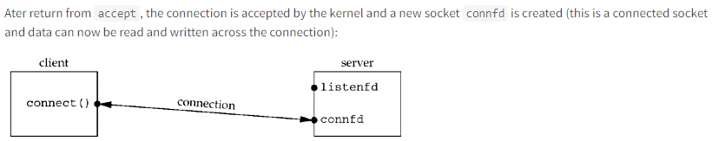
Visualizing the sockets and connection
The following figures visualize the sockets and connection in the code above:
Before call to accept returns, the server is blocked in the call to accept and the connection request arrives from the client:

Slide 56
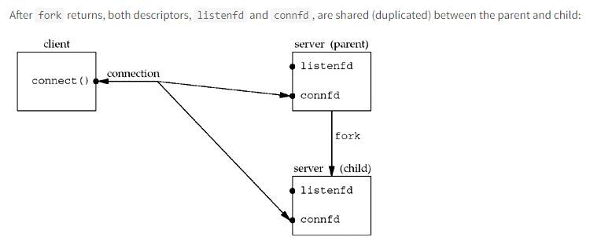

Slide 57
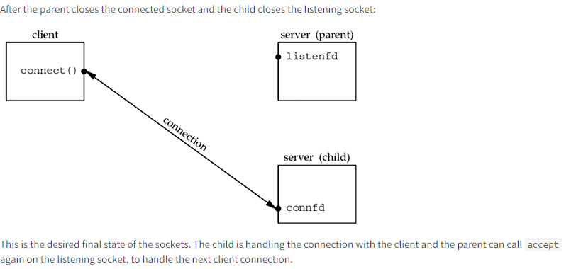

Slide 58
getsockname and getpeername Functions
getsockname returns the local protocol address associated with a socket.
getpeername returns the foreign protocol address associated with a socket.
#include <sys/socket.h>
int getsockname(int sockfd, struct sockaddr *localaddr, socklen_t *addrlen);
int getpeername(int sockfd, struct sockaddr *peeraddr, socklen_t *addrlen); /* Both return: 0 if OK, -1 on error */
The addrlen argument for both functions is value-result argument: both functions fill in the socket address structure pointed to by localaddr or peeraddr.
The term "name" in the function name is misleading. These two functions return the protocol address associated with one of the two ends of a network connection, which for IPV4 and IPV6 is the combination of an IP address and port number. These functions have nothing to do with domain names.
These two functions are required for the following reasons:

Slide 59
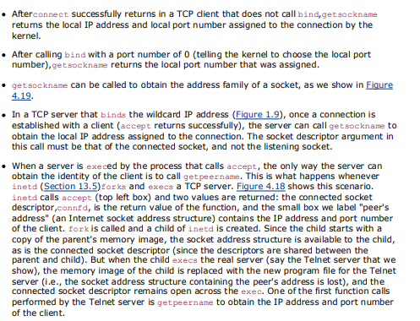
These two functions are required for the following reasons:

